Slide 1

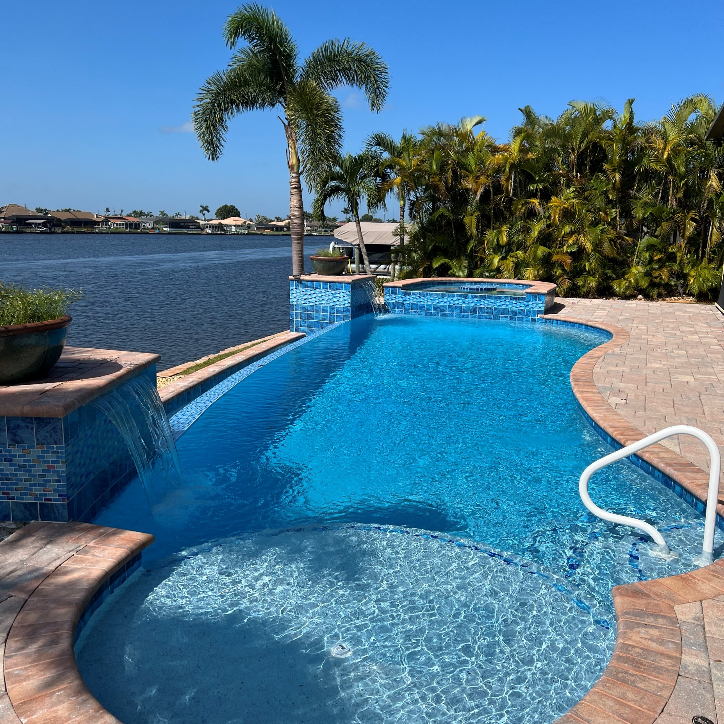

Congratulations!
Your Pool will soon be beautiful!
This Photo by Unknown author is licensed under CC BY.

Slide 2

Tips for having a successful Renovation
If possible, have the pool full and the water clear before we begin
Ensure your pump and filter are in good working order and the filter is clean
Cover or remove items from construction area
Have a person available to monitor water level when filling pool after renovation is complete

Slide 3

We immediately order your materials upon receiving a signed contract with 1st deposit

Slide 4
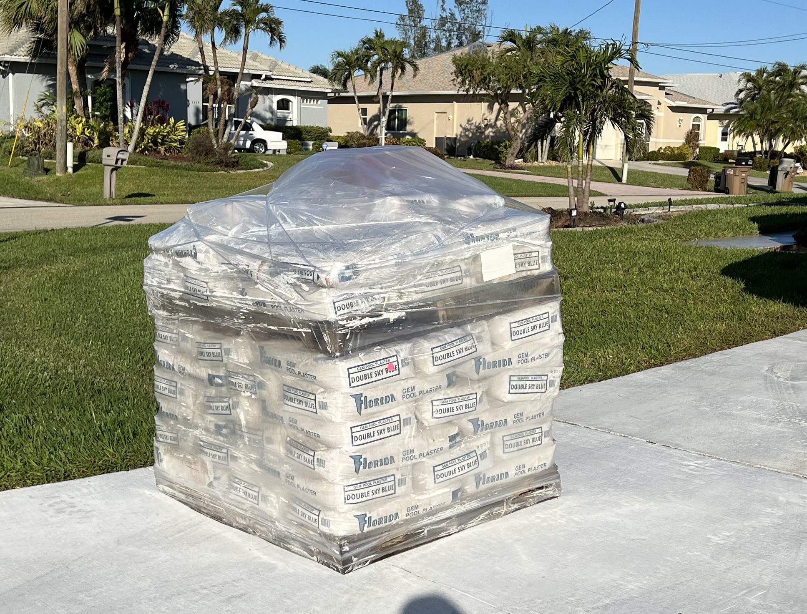
When your materials arrive they will be delivered to your driveway on a pallet.

Slide 5
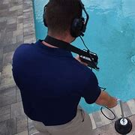
Leak detection will come out and check your pool for any leaks

Slide 6

Once your leak detection is complete Randy Thomas will contact you to schedule our work

Slide 7
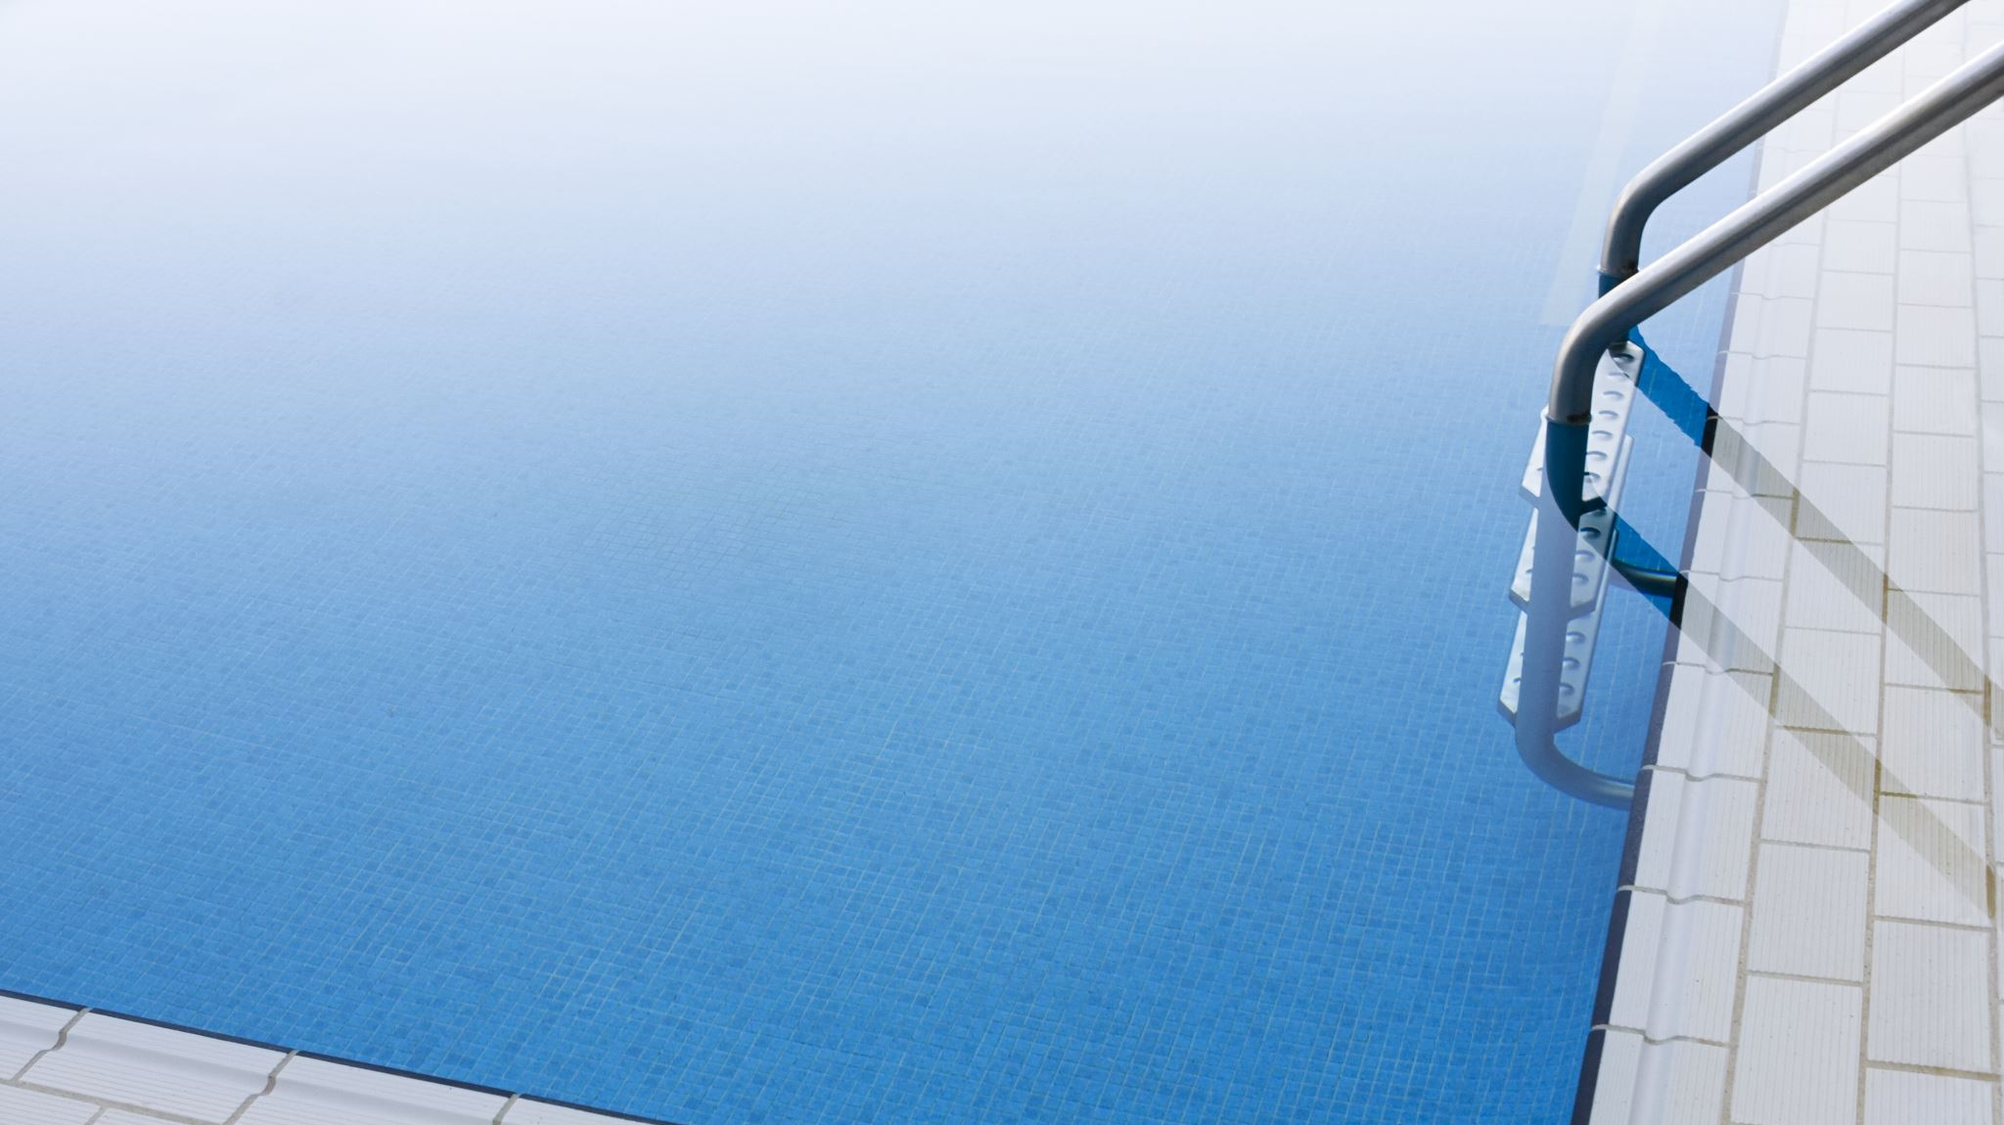
our crew will come out to prep your pool for resurfacing.

Slide 8
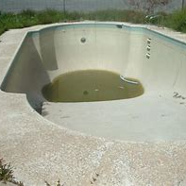
We will neutralize any Chlorine in the pool and drain the water out.

Slide 9
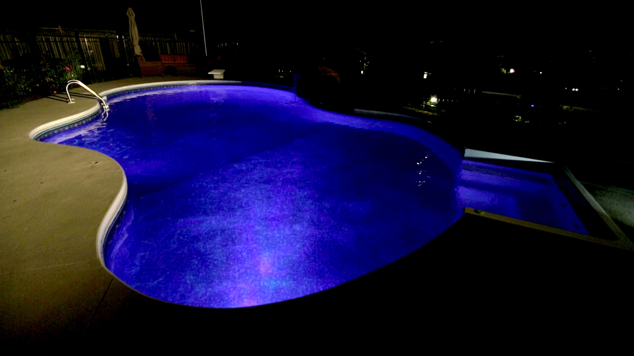
If you would like a new pool light – this is the time to install – while your pool is empty

Slide 10

Once the pool is empty, we will start the demo - removing any air pockets and all soft spots on surface and prepping the tile

Slide 11
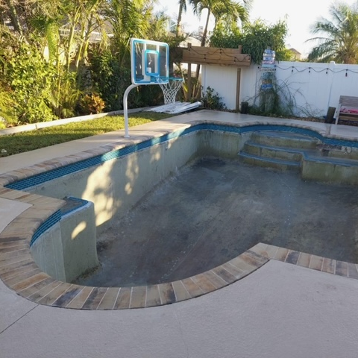
We will install the new tile and add the inlay tile to the raised areas We will also collect 2nd deposit at this time

Slide 12
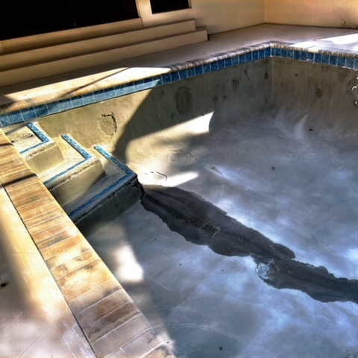
Next the bond coat will be applied

Slide 13
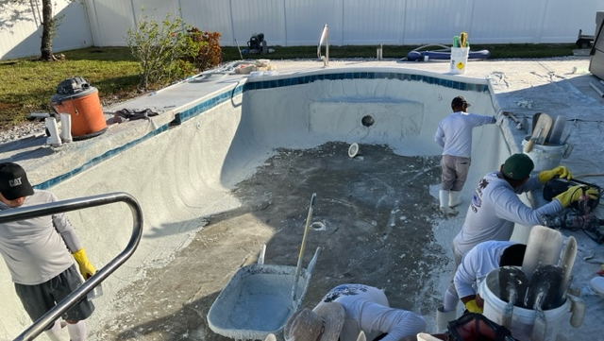
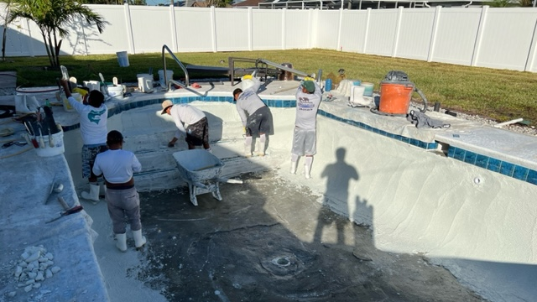
Now it's time to apply the new surface!

Slide 14
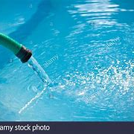
Time to fill the pool

Slide 15
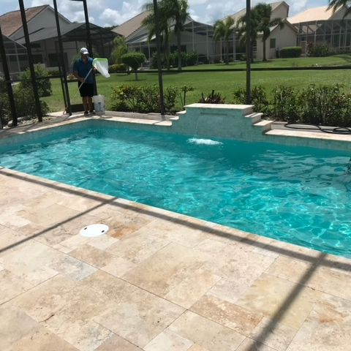
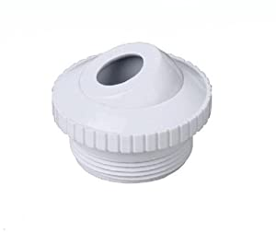
Once your pool is filled - we will collect 3rd and final deposit and weekly aftercare will begin
Your new return jets will be installed during aftercare

Slide 16

Once the final deposit has been collected you will be emailed your paid invoice, water form and information regarding your aftercare

Slide 17

During Aftercare
In order for your new surface to cure correctly please follow these recommendations
* Do Not put a vacuum in the pool
* Do Not turn on your heater
* Do Not add salt for a salt system
* Do let your aftercare technician know if you want to swim during aftercare

Slide 18
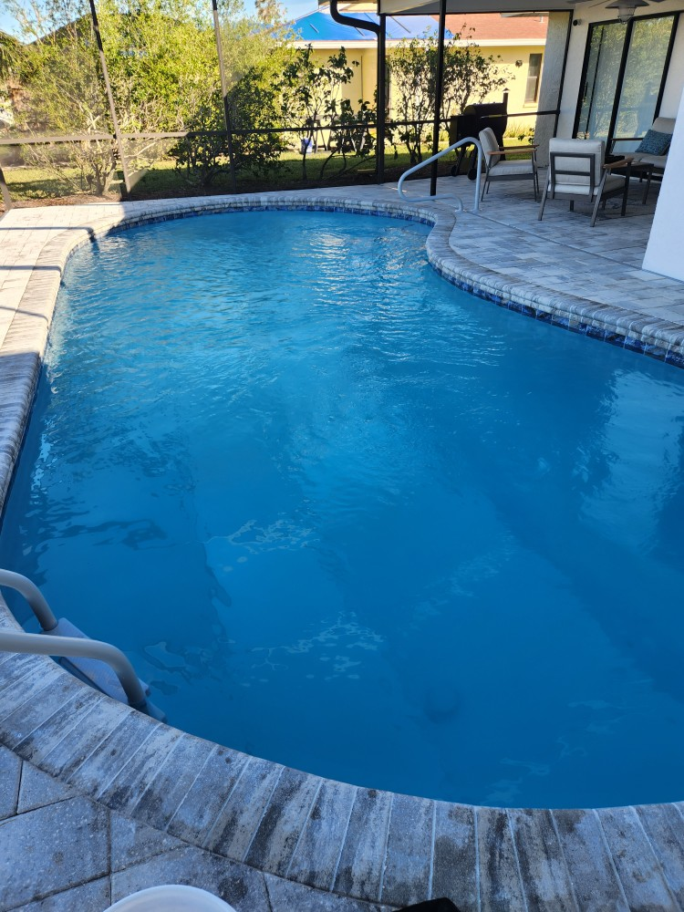
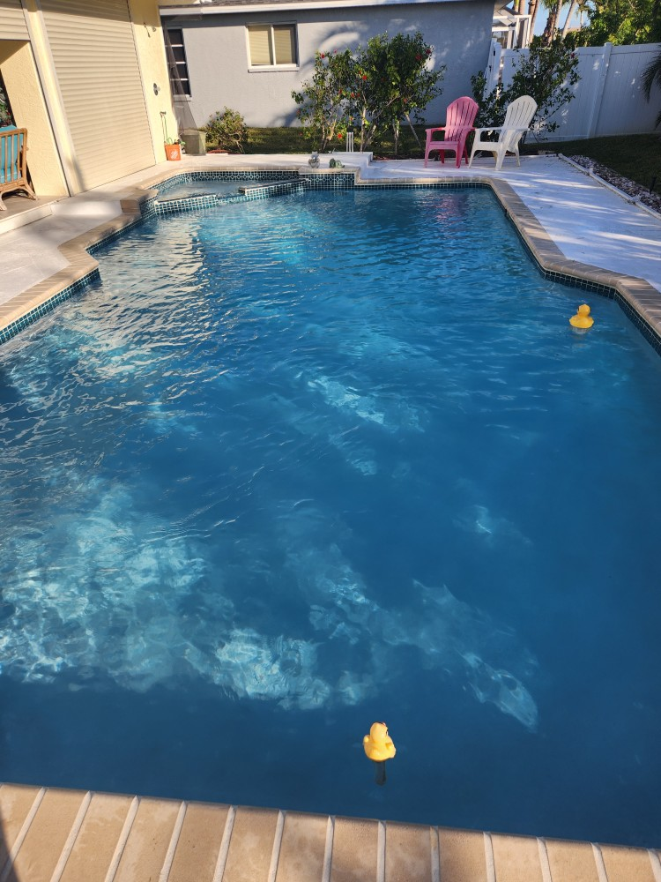
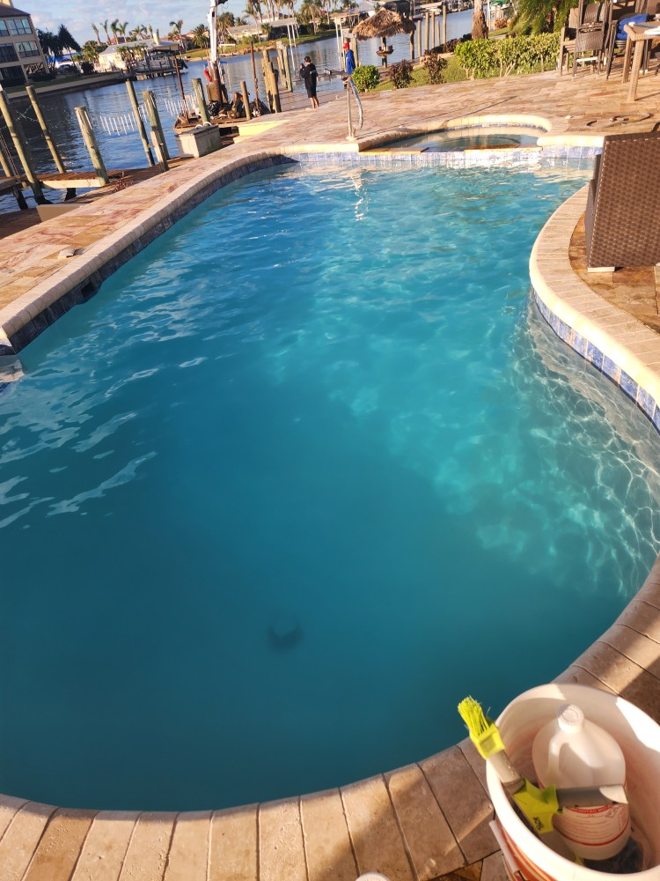
Enjoy your new pool!!!!

Slide 19
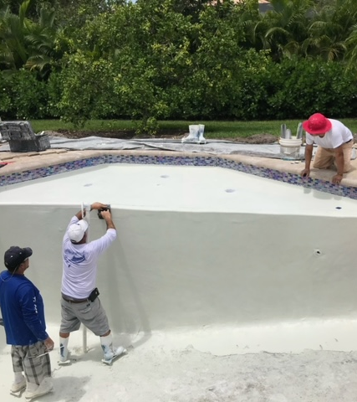
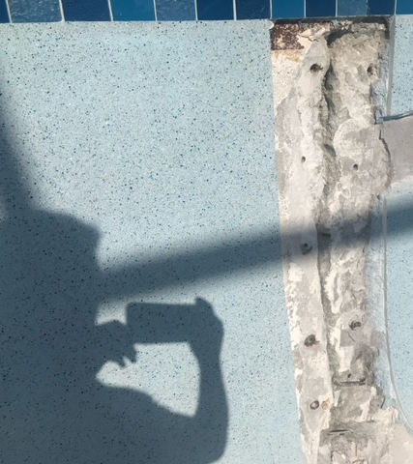
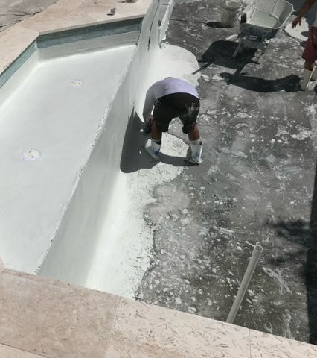
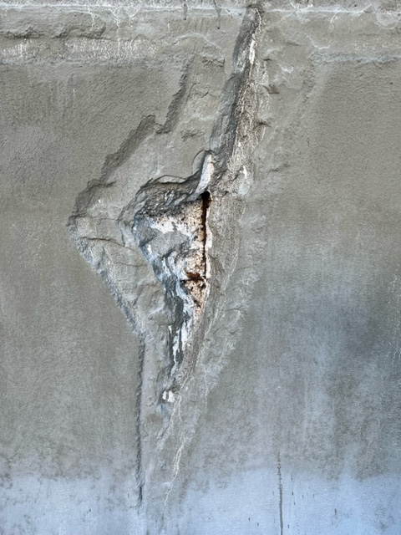
Extras – Sun shelf addition Bench addition Crack repairs

Slide 20


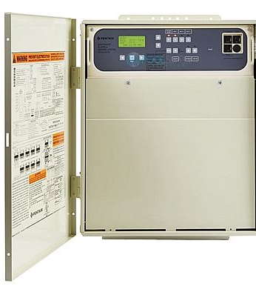
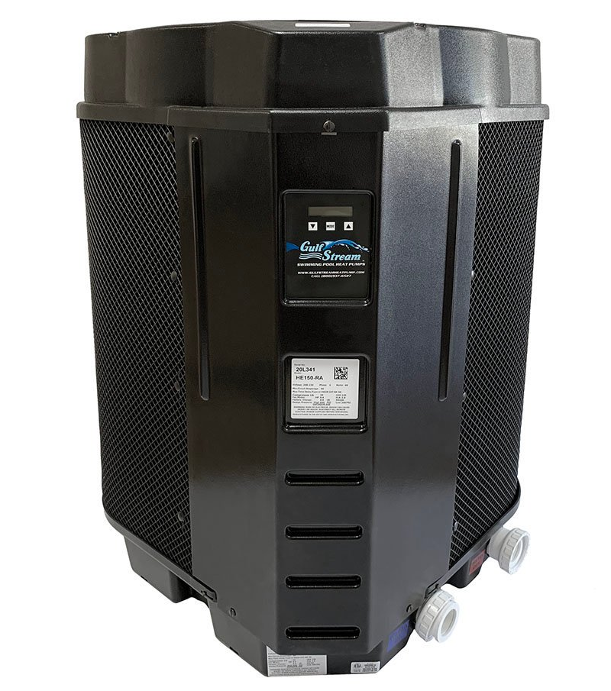
More Extras – Equipment upgrade and heater installs

Slide 21
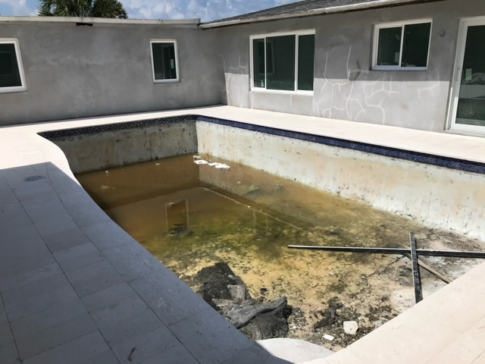
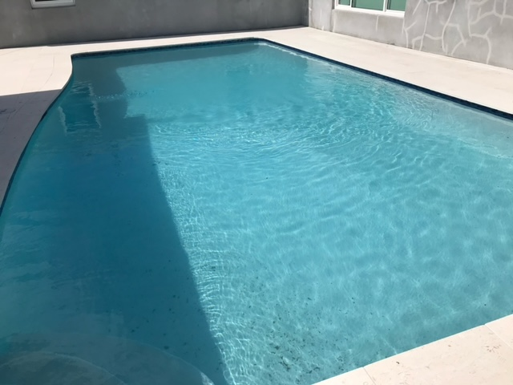
Before and After

Slide 22
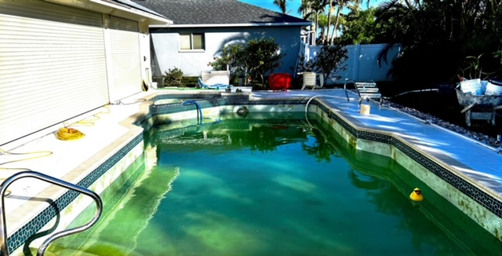
Before and After

Slide 23
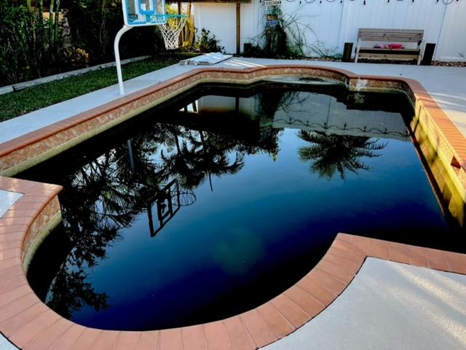
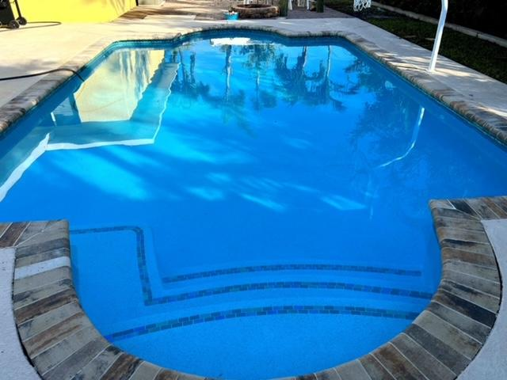
Before and after

Slide 24
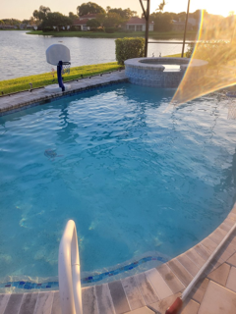
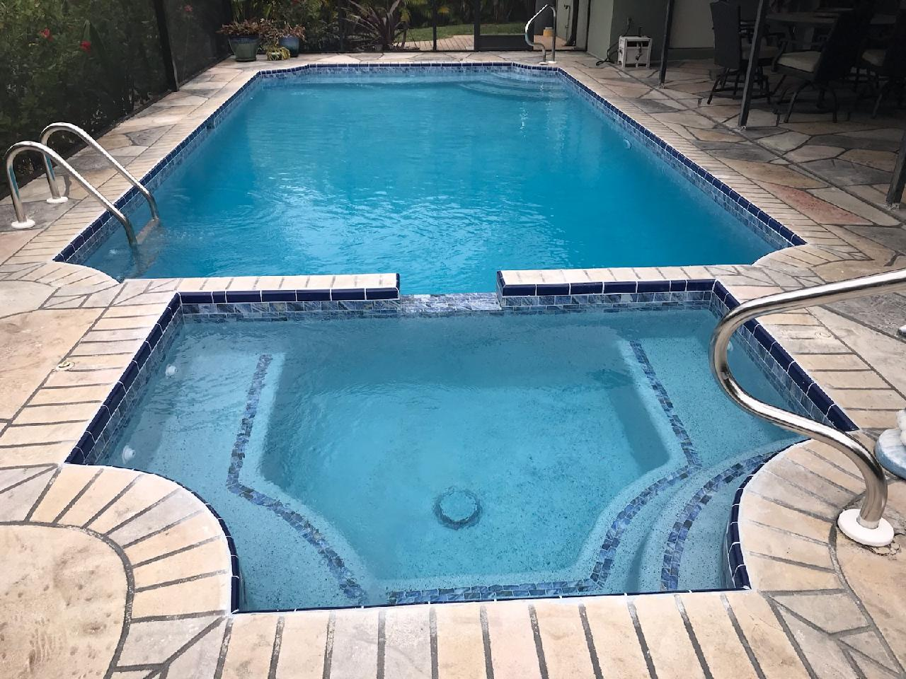
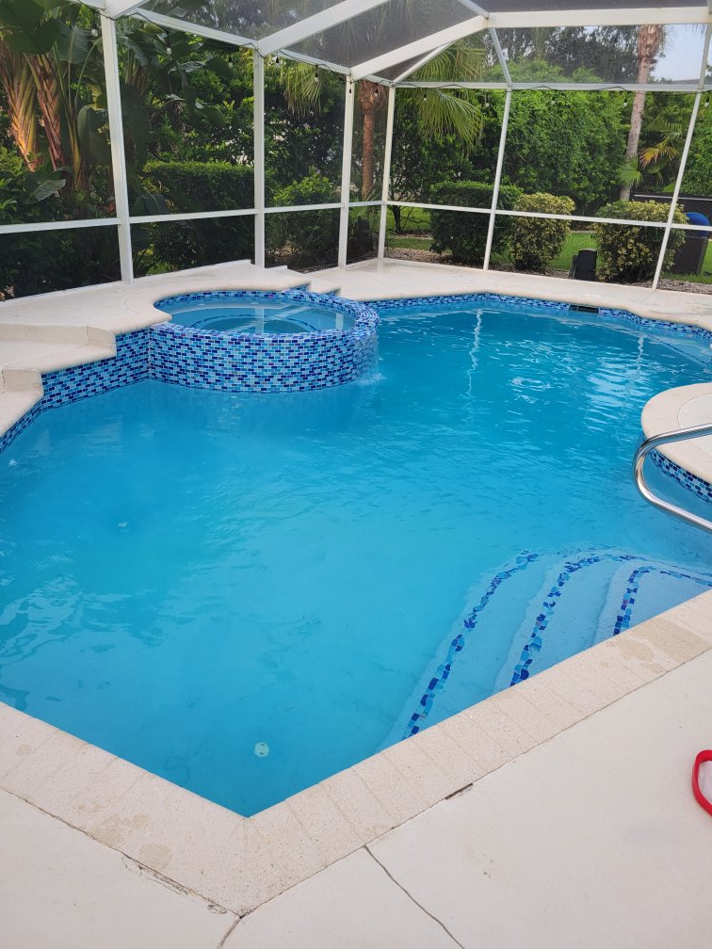
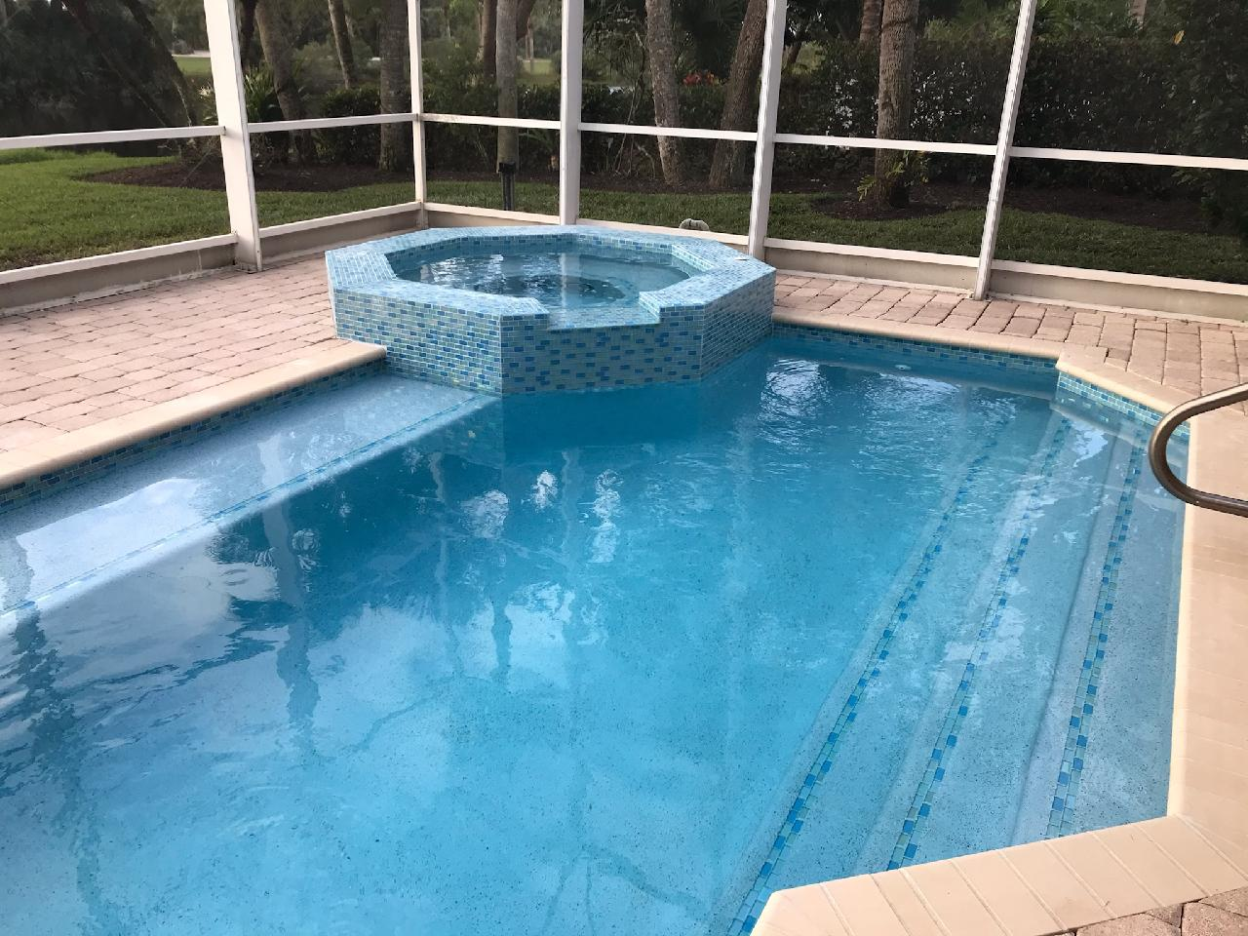
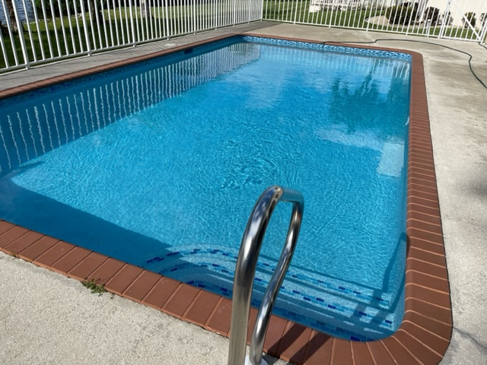
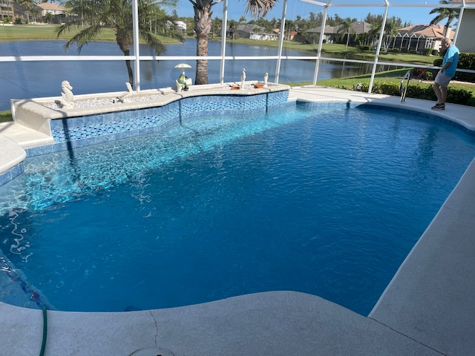
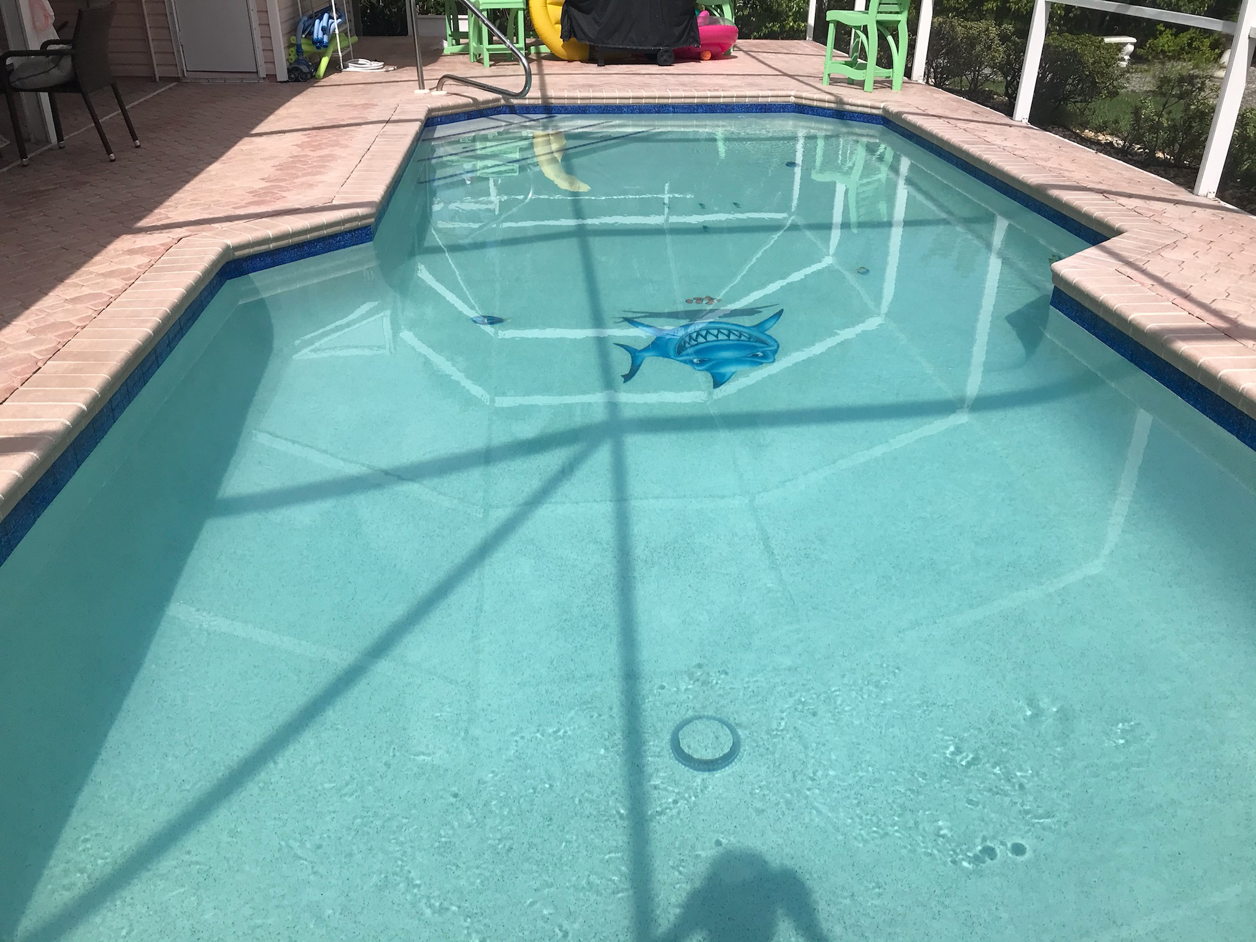
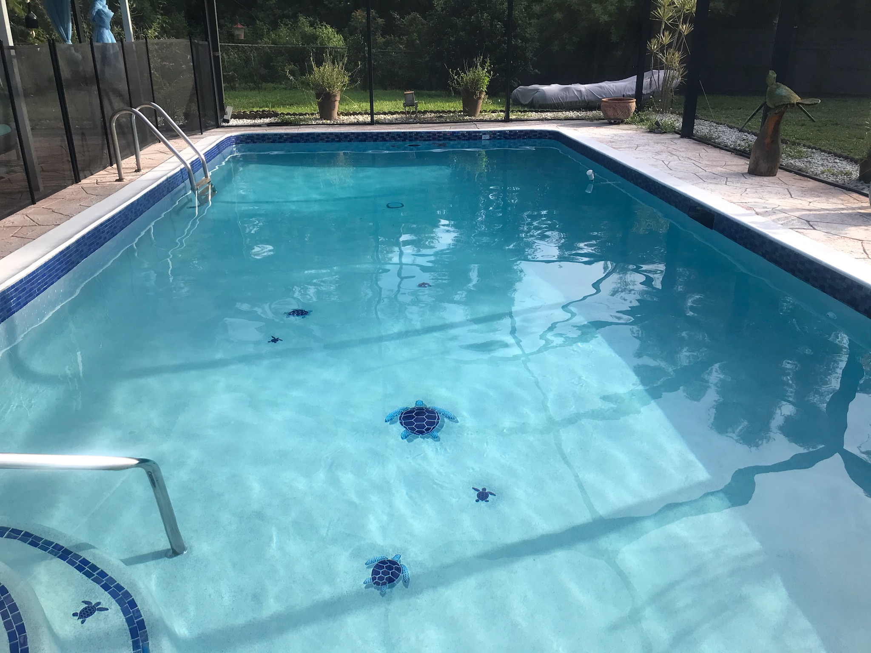
More pool renovations by Coastal Pool Renovations

Slide 25
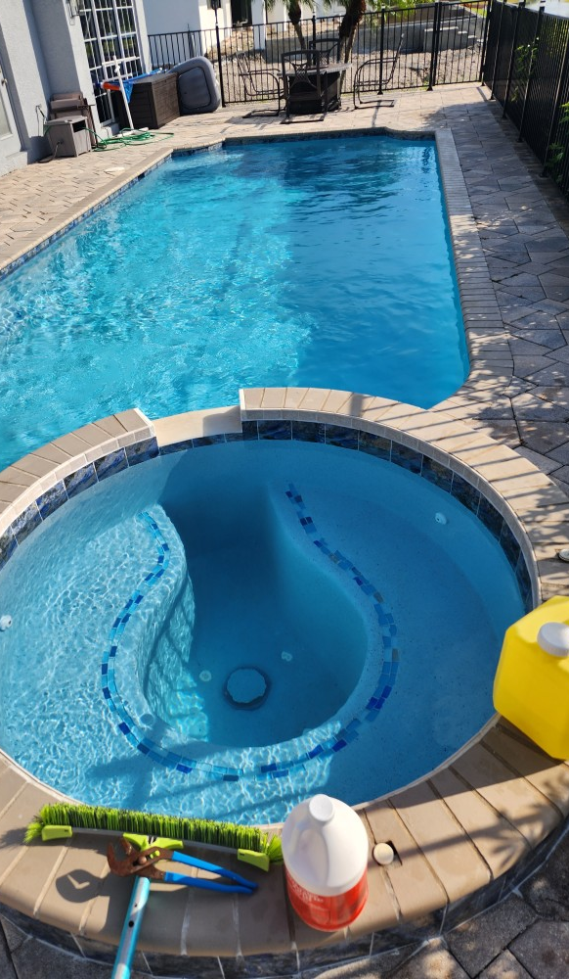
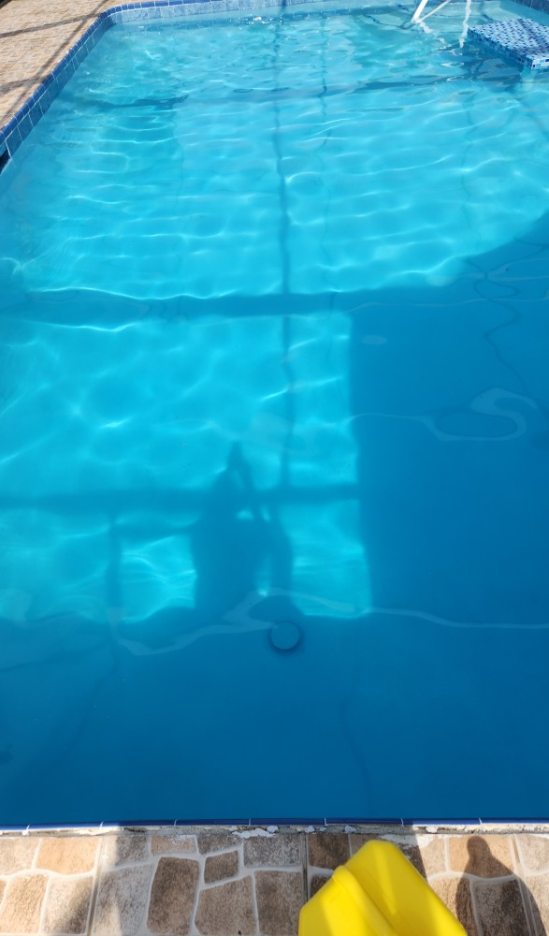
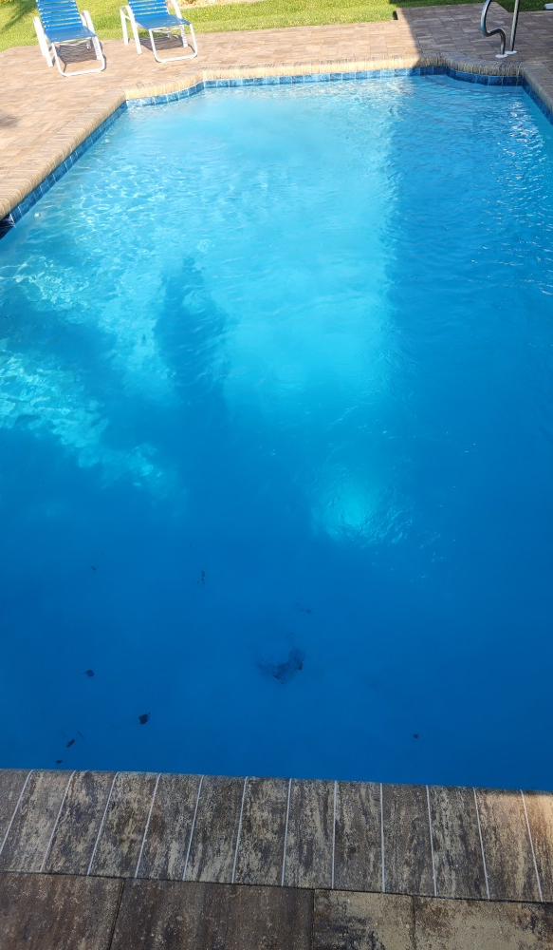

Slide 26
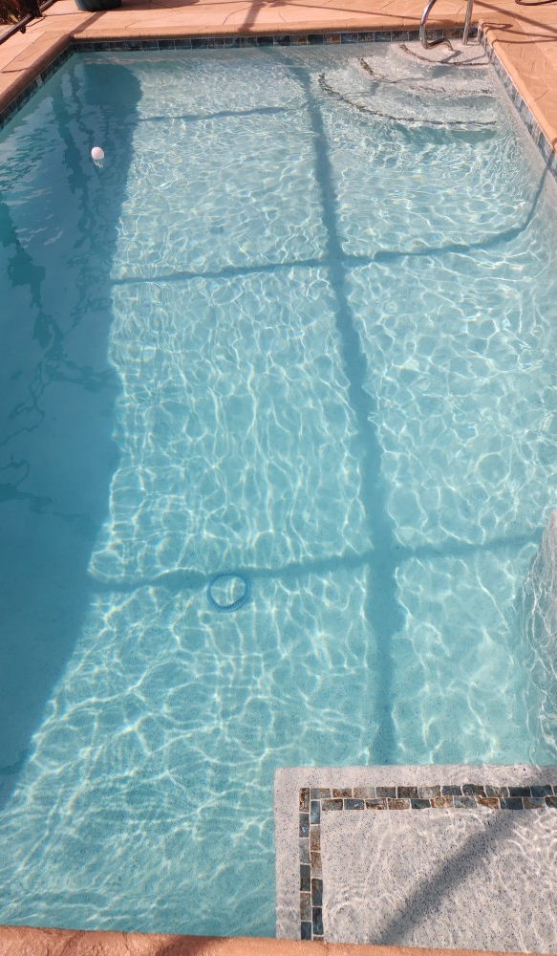
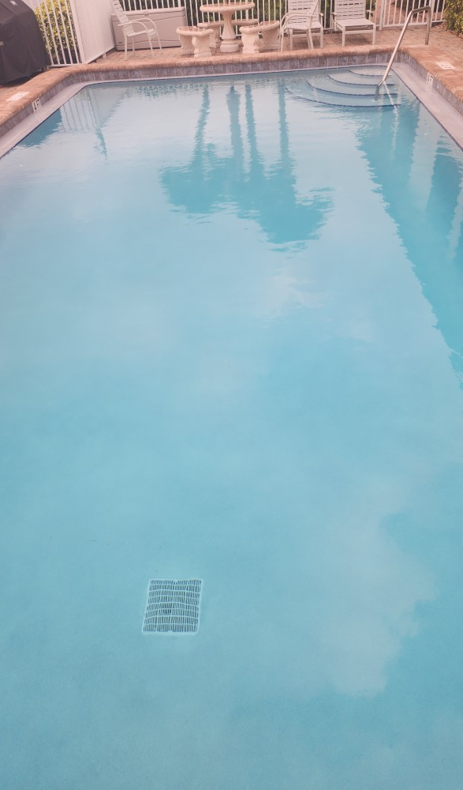
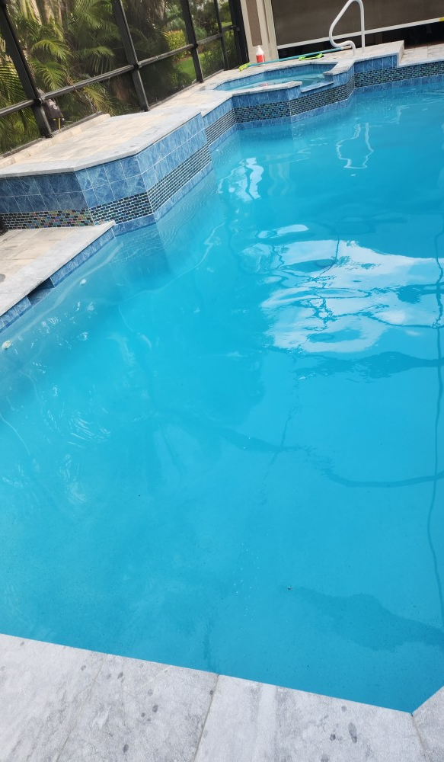

Slide 27
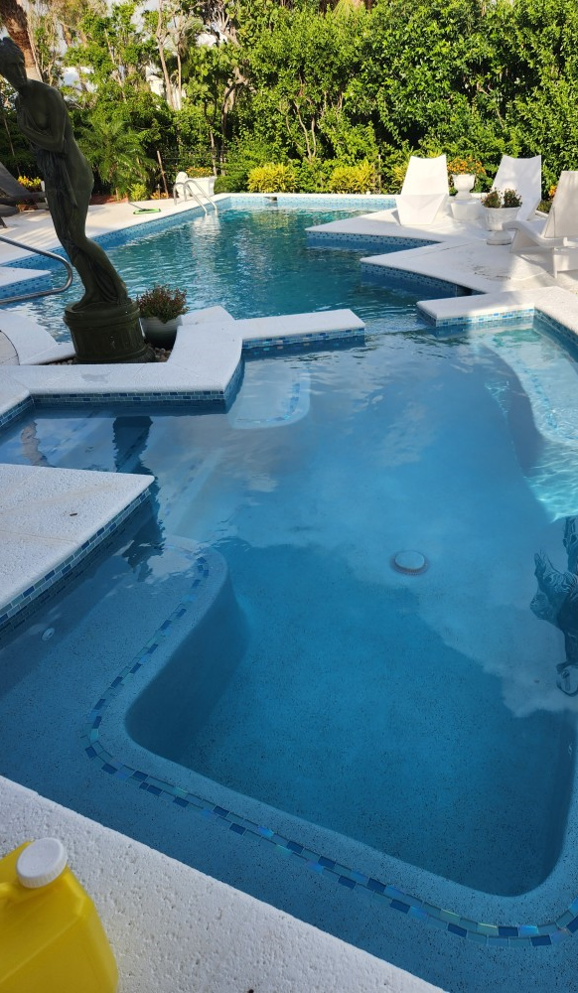
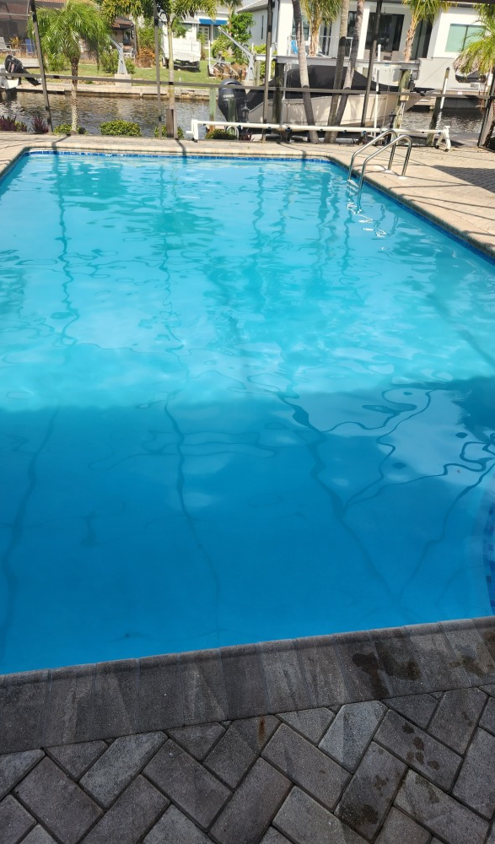
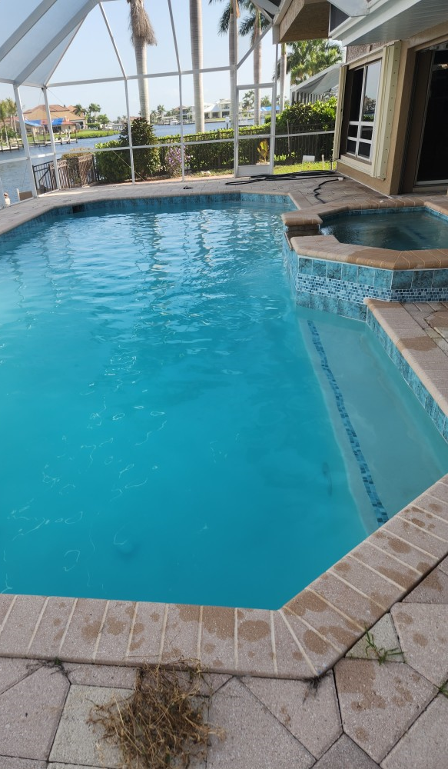

Slide 28
